Slide 1
PREDICTIVE MODELLING FOR COVID-19 IN PUBLIC HEALTH
BY
Favour Ini-Oluwa ISHOLA
FELLOW ID
FE/23/38197947
COHORT 2
30TH NOVEMBER, 2024.

Slide 2
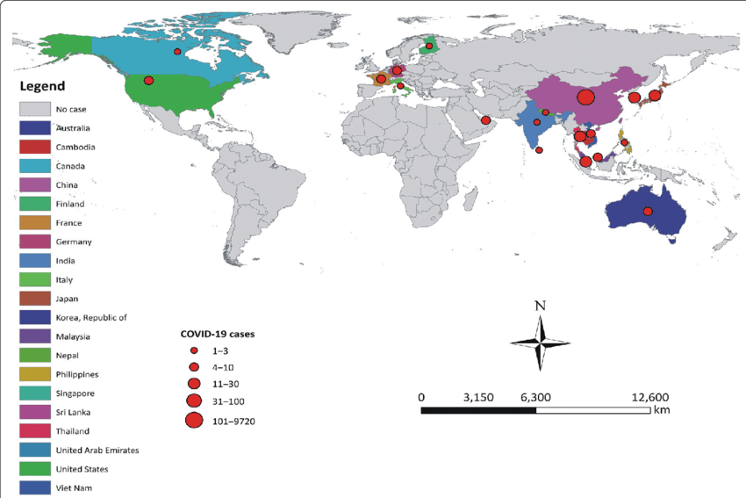
INTRODUCTION
OBJECTIVES OF THE PROJECT:
To analyse trends in COVID-19 data.
To predict future cases using time-series model.
To identify high-risk regions for targeted public health measures.
Global distribution of COVID-19 cases
Adhikari et al., 2020

Slide 3
DATA OVERVIEW
Dataset Involed Name | No of Rows | No of Columns | Key features
country_wise_latest | 112 | 18 | Confirmed, Deaths, Recovered and Active
covid_19_clean_complete | 42636 | 10 | Confirmed, Deaths, Recovered and Active
full_grouped | 28912 | 10 | Confirmed, Deaths, Recovered and Active
day_wise | 6 | 12 | Confirmed, Deaths, Recovered and Active
worldometer_data | 209 | 16 | Population
Data source: Kaggle

Slide 4
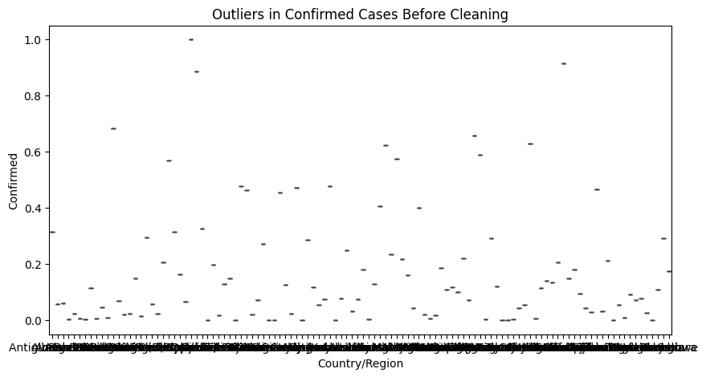
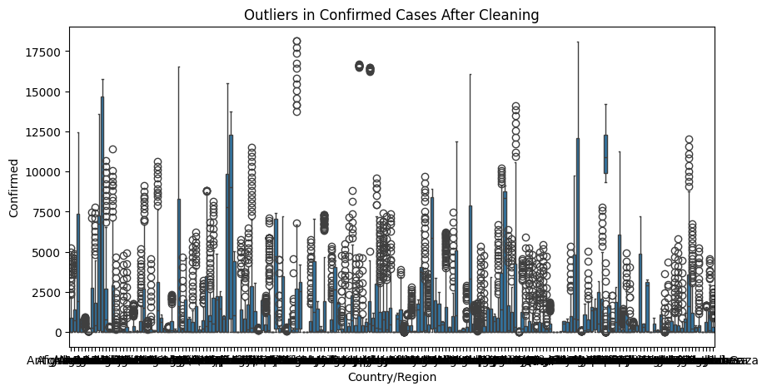
DATA PREPARATION
Data source: Kaggle

Slide 5
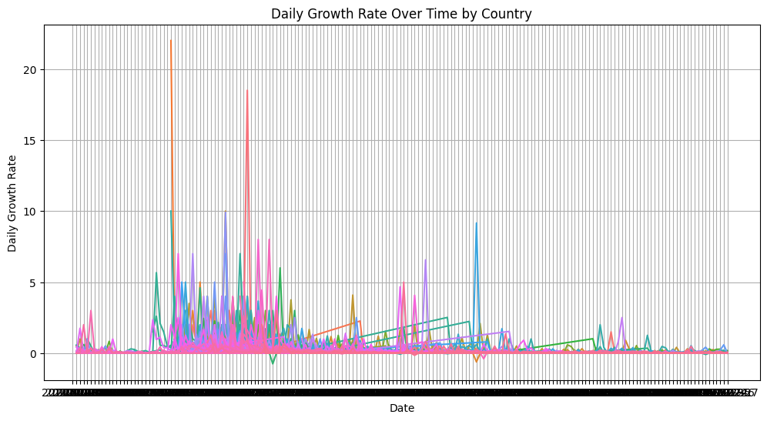
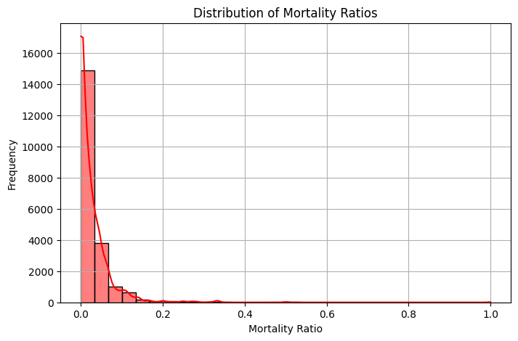
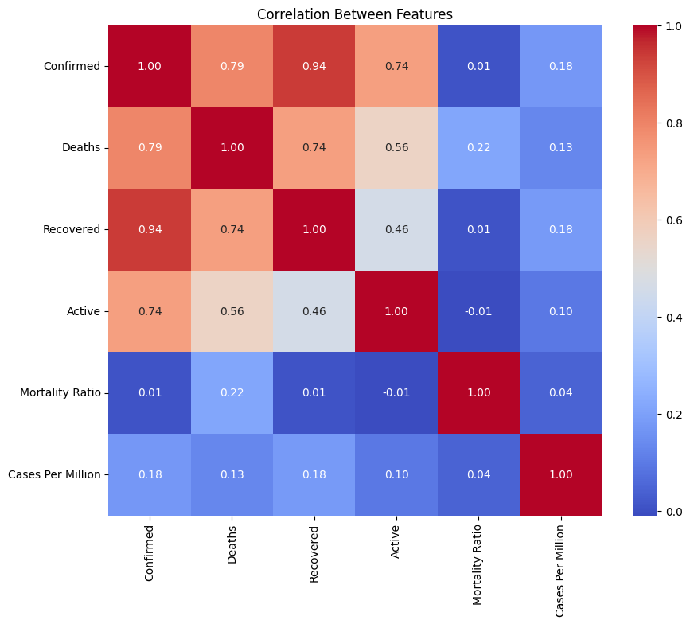
EXPLORATORY DATA ANALYSIS
Data source: Kaggle

Slide 6
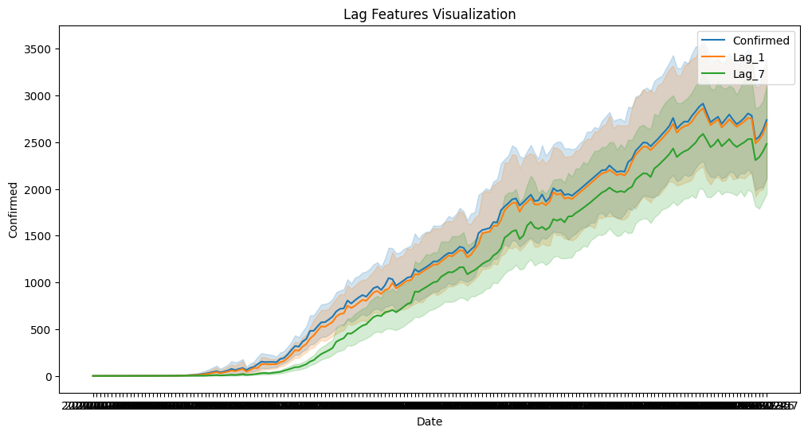
FEATURE ENGINEERING
Data source: Kaggle

Slide 7
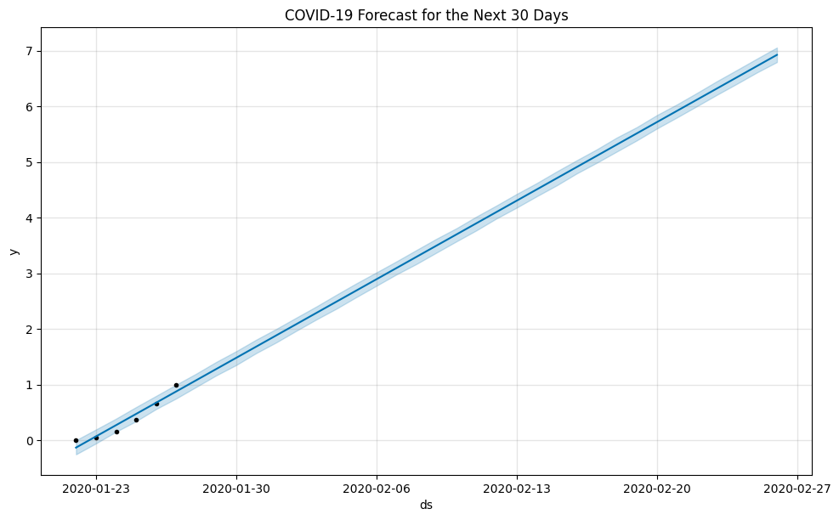
TIME-SERIES FORECASTING
Data source: Kaggle

Slide 8
CLASSIFICATION MODEL
 | Precision | Recall | F1-score | Support
0 | 0.89 | 0.84 | 0.86 | 100
1 | 0.85 | 0.90 | 0.87 | 120
Data source: Kaggle

Slide 9
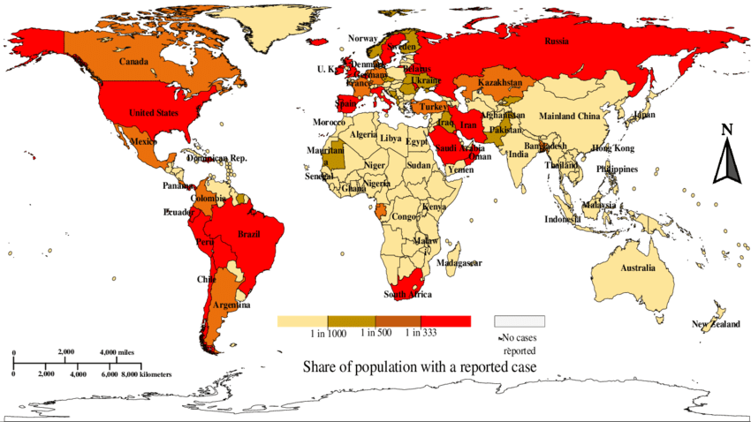
KEY INSIGHTS AND IMPLICATIONS
A world heat map of the corona pandemic per capita (COVID, 19)
Hasan et al., 2020

Slide 10
CONCLUSION
Data Analysis: Cleaned and analysed global COVID-19 data to uncover trends.
Key Insights: High-risk regions identified. Mortality ratios reveal healthcare strains.
Forecasting: Predicted case trends for the next 30 days using Prophet.
Classification: Used Random Forest to classify countries into risk levels.
Public Health Implications: Insights support resource allocation and targeted interventions.
Future Work: Incorporate vaccination data and explore advanced modelling techniques.

Slide 11

THANK YOU!

